Slide 1
Analysis of LAB dataset
PCSA
Release Date: DD-Mmm-YYYY

Slide 2
Agenda
What is Reference range?
Clinically Significant
PCSA Criteria
Categories OF PCSA
Example of PCSA Criteria
Mock shell of PCSA
ADLB Dataset /Specification(PCSA related variables)
Sample code for Programming of PCSA related variables
Reference paper for reading

Slide 3
Reference Range
A reference range is a set of values that includes upper and lower limits of a lab test based on a group of otherwise healthy people. The values in between those limits may depend on such factors as age, sex, and specimen type (blood, urine, spinal fluid, etc.) and can also be influenced by circumstantial situations such as fasting and exercise. These intervals are thought of as "normal ranges or limits."
Reference ranges provide the values to which your healthcare provider compares your test results to and determines your current health status.
Reference ranges help describe what is typical for a particular group of people based on age, sex, and other characteristics.
Laboratories report patient test results along with their reference ranges. Results that are out of range are typically highlighted and may include a comment.
when out-of-range results have clinical significance. Some reports include "critical values" that represent potentially life-threatening abnormalities.
Every laboratory identifies certain key tests that have been associated with these life-threatening events whereby critical values are required to be immediately reported to the health practitioner.

Slide 4
Clinically Significant
An abnormal lab value should be deemed clinically significant if either of the following conditions is met:
The abnormality suggests a disease and/or organ toxicity that is new or has worsened from baseline.
☞ The abnormality is of a degree that requires additional active management, e.g., change of dose, discontinuation of the drug, close observation, more frequent follow-up assessments, or further diagnostic investigation.
☞ Therefore, a clinically significant lab value is one that indicates a new disease process, an exacerbation or worsening of an existing condition, or requires further action(s) to be taken.

Slide 5
PCSA Criteria
The Center for Drug Evaluation and Research (CDER) considered a clinical safety review “should focus on patients whose laboratory values deviate substantially from the reference range”.
In a Reviewer Guidance: Conducting a Clinical Safety Review of a New Product Application and Preparing a Report on the Review [1], since the changes in laboratory values are “much more likely to identify significant problems than mean or median change from baseline”.
Reports of Potentially Clinically Significant Abnormalities (PCSA) from laboratory, Vital signs, and ECG values for selected parameters are important parts of the safety review as they provide patient information of significant deviation from normal while on treatment by treatment groups.
Decisions about criteria for identifying outliers should, if possible, be made at the pre-NDA meeting, and the PCS criteria will be defined in SAP with the input from Medical Directors.
PCS Criteria are provided by the company clinical group and documented in Statistical Analysis Plan (SAP).

Slide 6
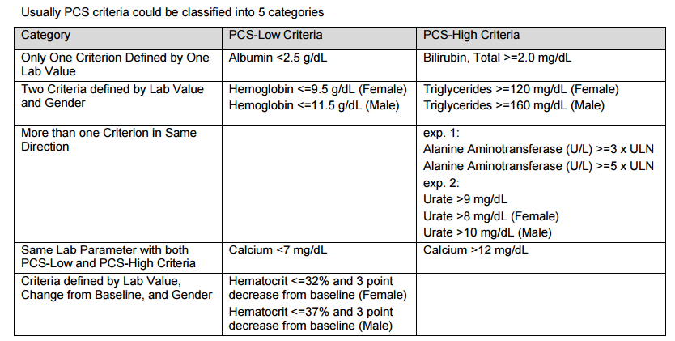
Categories of PCSA

Slide 7
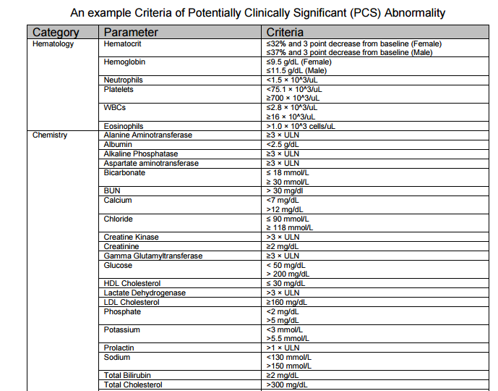
Example of PCSA criteria

Slide 8
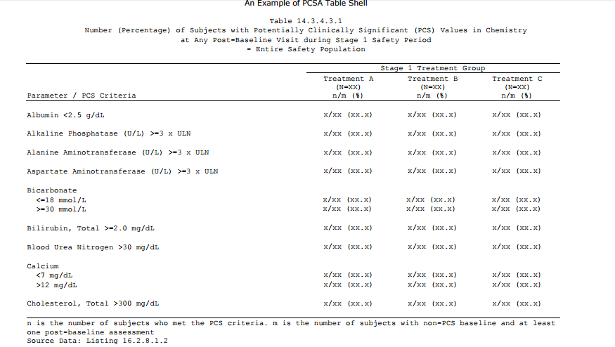
Mock shell of PCSA report

Slide 9
ADLB dataset (PCSA related Variables)
Variables for generating PCSA tables in ADaM ADLB will be created based on SAP.
In ADLB, two or three analysis criterion variables, CRIT1, CRIT2, and /or CRIT3 along with criterion evaluation result flags, CRIT1FL,CRIT2FL, and/or CRIT3FL are applied to identify whether a PCS criterion is met for selected parameters.
PCS VARIABLES CRIT1, CRIT1FL, CRIT2, CRIT2FL, CRIT3, AND CRIT3FL In ADaM IG 1.1, there are two BDS Standard Variables CRITy (Analysis Criterion y) and CRITyFL (Criterion y Evaluation Result Flag) to identify whether a PCS criterion is met for a parameter. Per the Classification of PCS criterion in Table 2, CRIT1 and CRT1FL are applied to PCS-Low, and CRIT2 and CRT2FL along with CRIT3 and CRT3FL are for PCS-High. When developing a SAS program for PCSA tables, we can select records with first nonmissing minimal value among all post-baseline visits for all CRIT1 criteria, and select records with first non-missing maximal value among all post-baseline visits for all CRIT2 criteria. If there are more than one criterion for PCS-High, A Methodology of Laboratory Data Reporting of Potentially Clinical Significant Abnormality (PCSA) for Clinical Study Report, continued 3 CRIT3 and CRIT3FL are applied for the second Criterion for PCS-High.

Slide 10
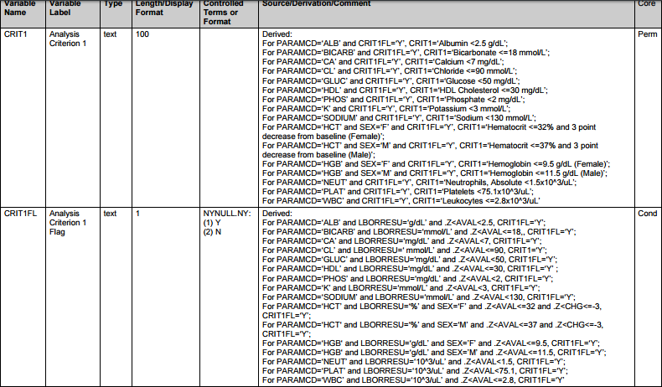
Specification of PCSA Related Variable

Slide 11
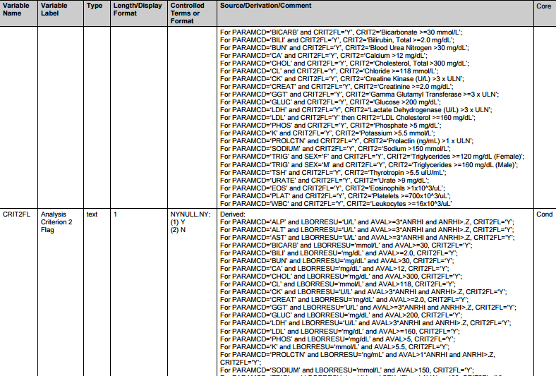
Specification of PCSA Related Variable

Slide 12
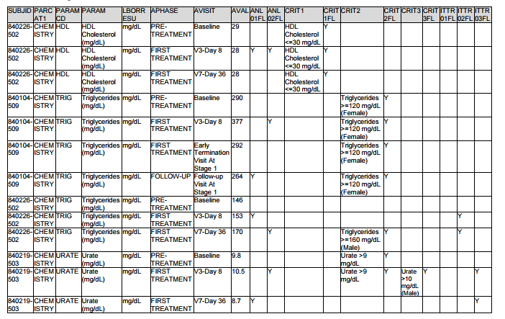
Snapshot of ADLB dataset

Slide 13
Sample code for Programming of CRIT1, CRIT1FL
*** CRIT1, CRIT1FL ***;
if paramcd='ALB' & lborresu='g/dL' & .<aval<2.5 then do; crit1fl='Y'; crit1='Albumin <2.5 g/dL'; end;
if paramcd='CA' & lborresu='mg/dL' & .<aval<7 then do; crit1fl='Y'; crit1='Calcium <7 mg/dL'; end;
if paramcd='GLUC' & lborresu='mg/dL' & .<aval<50 then do; crit1fl='Y'; crit1='Glucose <50 mg/dL'; end;
if paramcd='K' & lborresu='mmol/L' & .<aval<3 then do; crit1fl='Y'; crit1='Potassium <3 mmol/L'; end;
if paramcd='SODIUM' & lborresu='mmol/L' & .<aval<130 then do; crit1fl='Y'; crit1='Sodium <130 mmol/L'; end;
if paramcd='HCT' & lborresu='%' & .<aval<=32 & .<CHG<=-3 & sex='F' then do; crit1fl='Y'; crit1='Hematocrit <=32% and 3 point decrease from baseline (Female)'; end;
if paramcd='HCT' & lborresu='%' & .<aval<=37 & .<CHG<=-3 & sex='M' then do; crit1fl='Y'; crit1='Hematocrit <=37% and 3 point decrease from baseline (Male)'; end;
if paramcd='HGB' & lborresu='g/dL' & .<aval<=9.5 & sex='F' then do; crit1fl='Y'; crit1='Hemoglobin <=9.5 g/dL (Female)'; end;
if paramcd='HGB' & lborresu='g/dL' & .<aval<=11.5 & sex='M' then do; crit1fl='Y'; crit1='Hemoglobin <=11.5 g/dL (Male)'; end;
if paramcd='NEUT' & lborresu='10^3/uL' & .<aval<1.5 then do; crit1fl='Y'; crit1='Neutrophils, Absolute <1.5x10^3/uL'; end;

Slide 14
Reference
Sample code for creating PCSA table is provided in the Reference paper attached.

Slide 15
Thank You

